Slide 1
Front End Engineering-I Project
Team Details:
Team members:
1. Ashish Jadon (2210991400)
2. Ashish Kumar(2210991401)
3. Ashish Ranjan(2210991402)
4. Ashish Sharma(2210991403)(Team Leader)
Faculty Coordinator: Dr. Anshu Singla (prof. DCSE)
:
Chitkara University Institute of Engineering and Technology,
Chitkara University, Punjab

Slide 2
Table of Contents
Introduction
Problem Statement
Technical Details
Key Features
Codes and Outputs
Conclusion
Regards
References/Links used

Slide 3
Introduction
Portfolio Maker
Team members:
1. Ashish Jadon(2210991400)
2. Ashish Kumar(2210991401)
3. Ashish Ranjan(2210991402)
4. Ashish Sharma(2210991403)
Goal: A portfolio website is a unique way to showcase your work and let others know about yourself. It's like an evergreen platform for your projects, case studies, and information about you.

Slide 4
Problem Statement
Benefits Of Creating An Online Portfolio:-
Professional Way To Showcase Your Work.
It's A Great First Impression For Employers.
Increases Your Visibility And Online Presence.
Shows You're More Than Just A Resume.
Flexibility.

Slide 5
Technical Details
Application used:- Visual Studio Code.
Programming Languages used: 1. HTML
2. CSS
3. JavaScript(JQuery Framework).

Slide 6
Key Features
Design
Logo With Tagline
High Quality images
Testimonials
Information about yourself
Contact Information

Slide 7
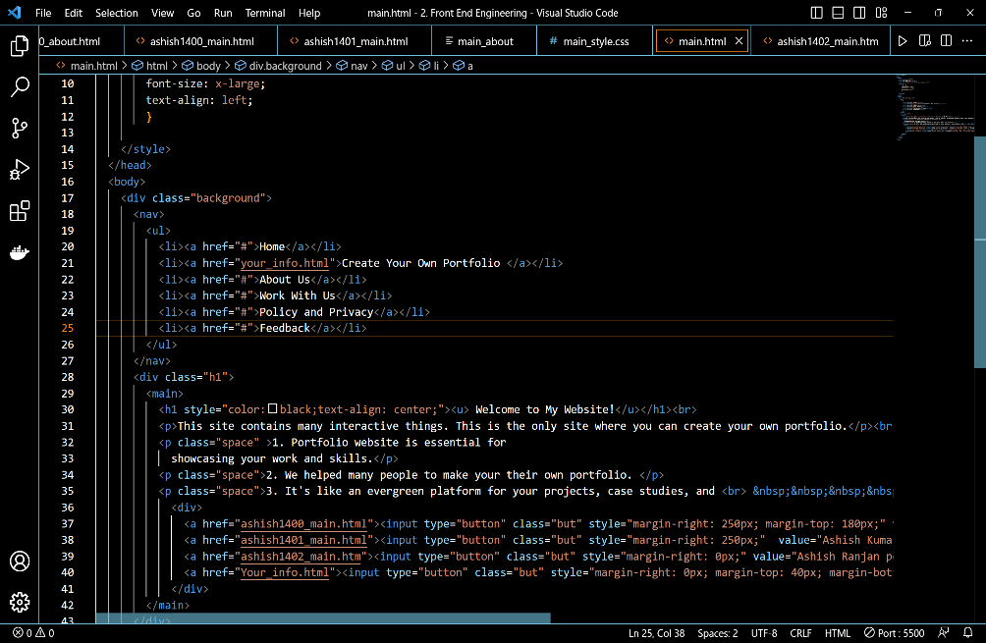
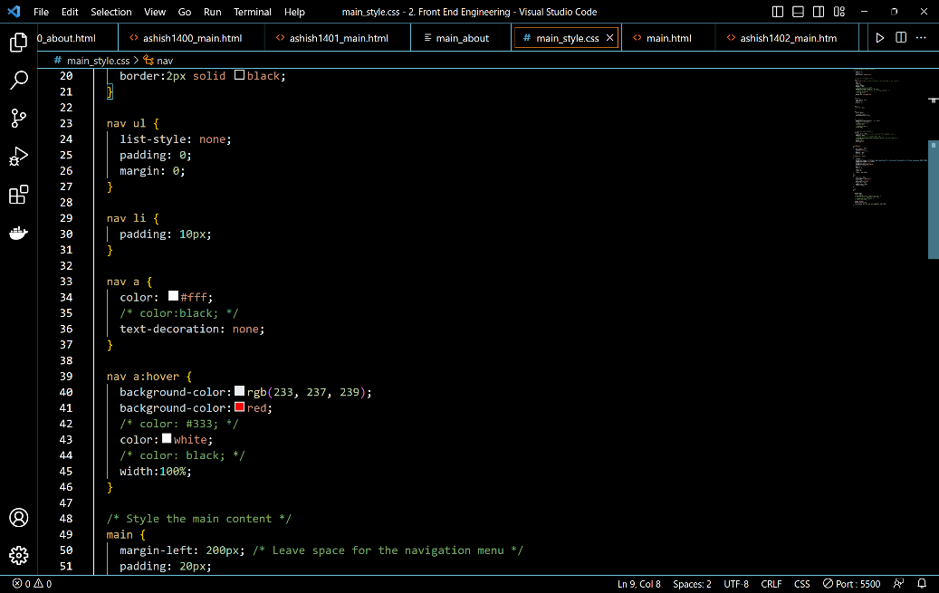
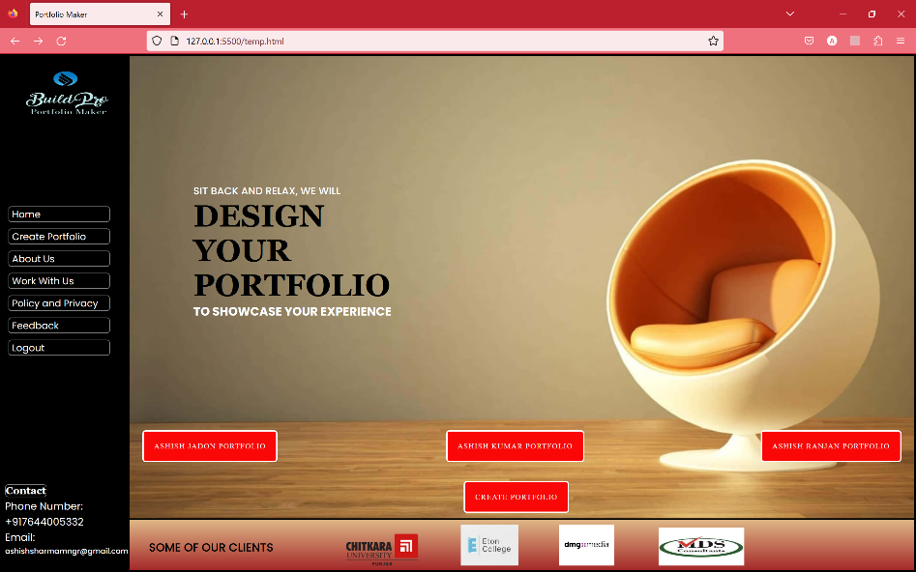
Codes and Outputs:-
HTML Code
CSS Work
Output

Slide 8
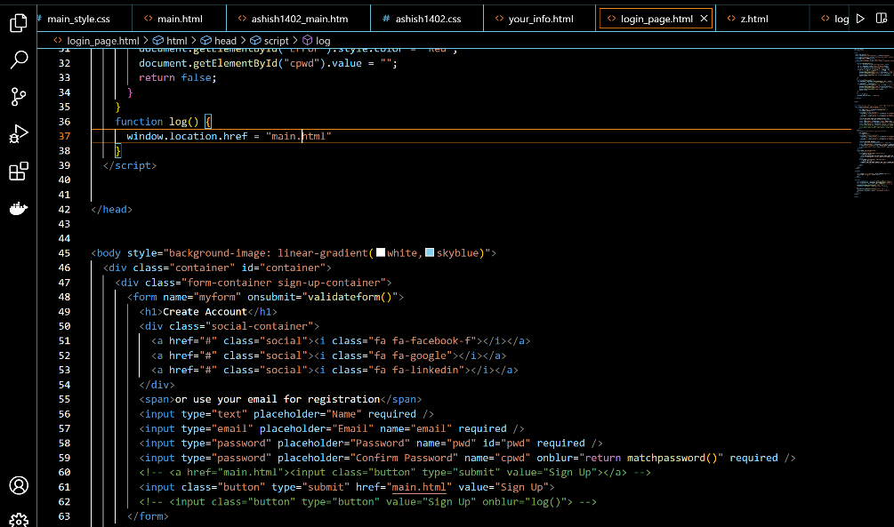
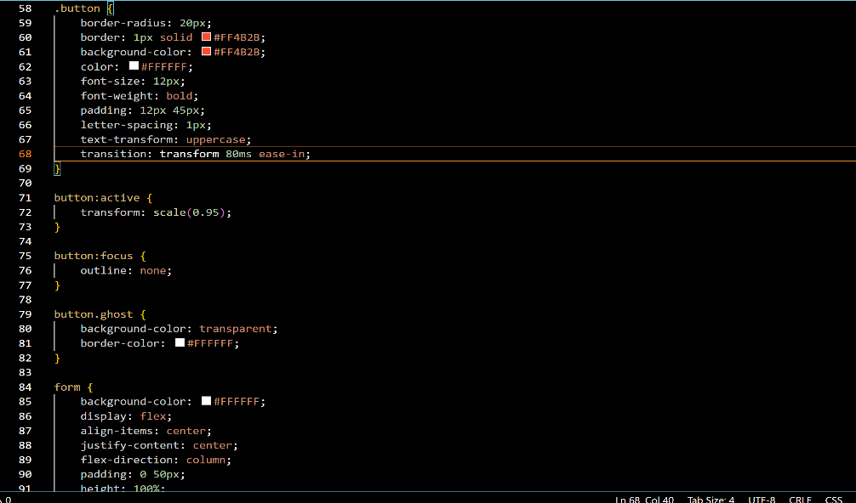
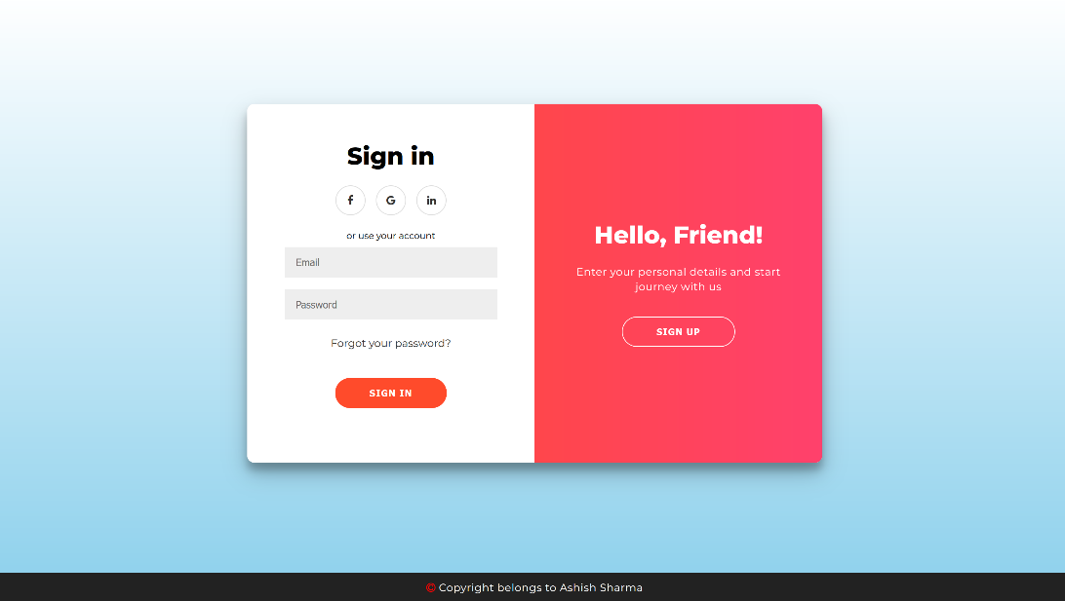
Codes and Outputs:-
HTML Code
CSS Work
Output

Slide 9
Conclusion
Portfolio is a very valuable and meaningful evaluation tool that effectively assesses student learning. Along with the student reflection the data provides the valuable information about how each student learns and what is important to him or her in the learning process.

Slide 10
Regards:-
Respected Dr. Anshu Singla and Ms. Preenu,
We want to extend a heartfelt thank you for your guidance and support throughout our project. As our respected mentor and teacher, you have played a crucial role in our journey of learning JavaScript and web development. Not only have you taught us the technical aspects, but you have also emphasized the importance of ethics and teamwork.
With your assistance and our team's collective effort, we have successfully achieved our project goal. However, we are not stopping there. We are committed to working hard and adding more features to make it even more interactive and user-friendly.
We are immensely grateful for the opportunity to learn from you and for your unwavering support. Your mentorship has not only helped us gain knowledge but has also taught us valuable lessons about collaboration and working together as a team.
Once again, thank you for everything.
Best regards,
Ashish Sharma (Team Lead)

Slide 11
References/Links used
The main Reference for this project is:- w3schools.
https://www.w3schools.com/ .
Link:- To Do List or https://www.w3schools.com/howto/howto portfolio.asp .
The Other Main source of reference for this project is:-
https://youtu.be/AkIUtUWpyZs .
The other important source used by us for this project is:-
https://code-projects.org/portfolio-web-application-in-javascript-with-source-code/ .

Slide 12


